Slide 1
Compre Review
Dr. Sugata Ghosal
CSIS Off-Campus Faculty
BITS Pilani

Slide 2
Comprehensive Exam Tips
5 Questions, 40 Marks
Perceptron / MLP Design, loss calculation, parameter updates with various methods, deep learning concepts
Decision Tree construction, Ensemble method calculation, conceptual question on overfitting, random forest
PCA, K-means clustering, Mixture of Gaussian Model calculation
CNN convolution calculation, # of parameter calculation, conceptual questions
RNN calculation, # of parameter calculation, calculation with text strings, conceptual questions
FAccT ML conceptual questions
Midsem topics (20-30%)

Slide 3
Classification Model II Decision Trees
Dr. Sugata Ghosal
CSIS Off-Campus Faculty
BITS Pilani

Slide 4
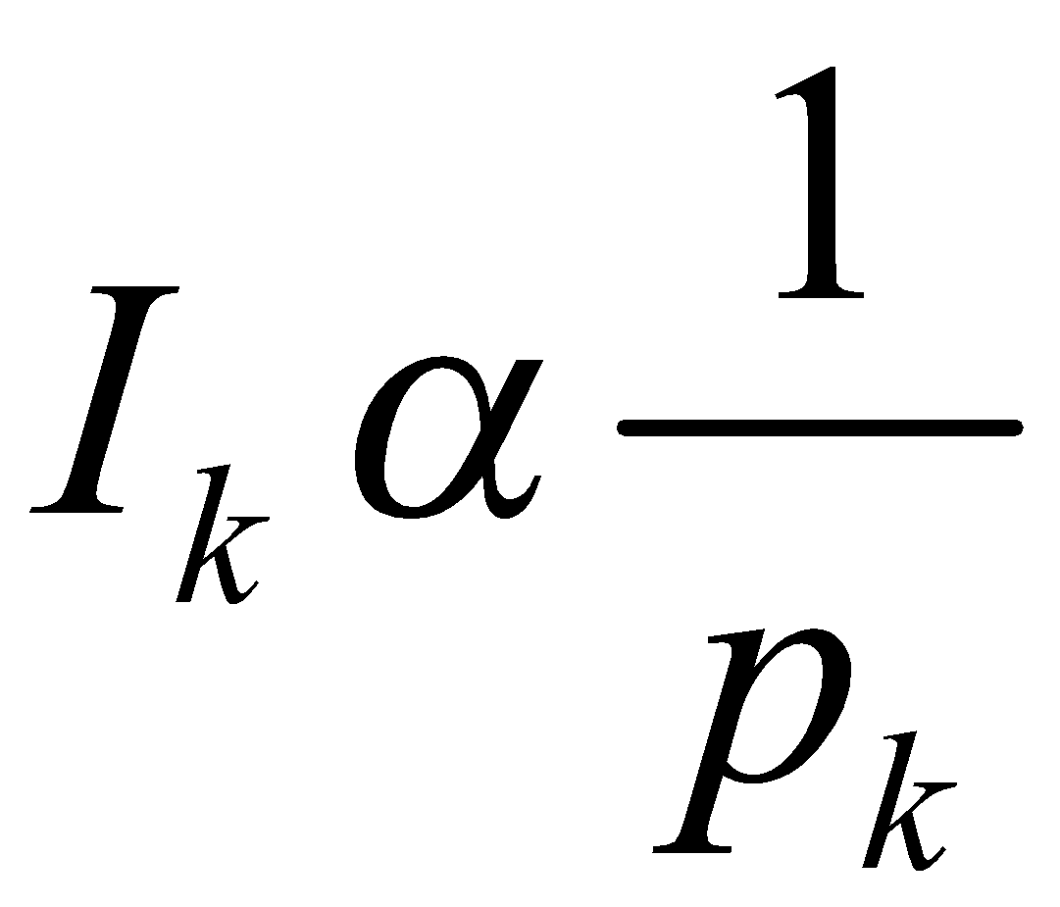
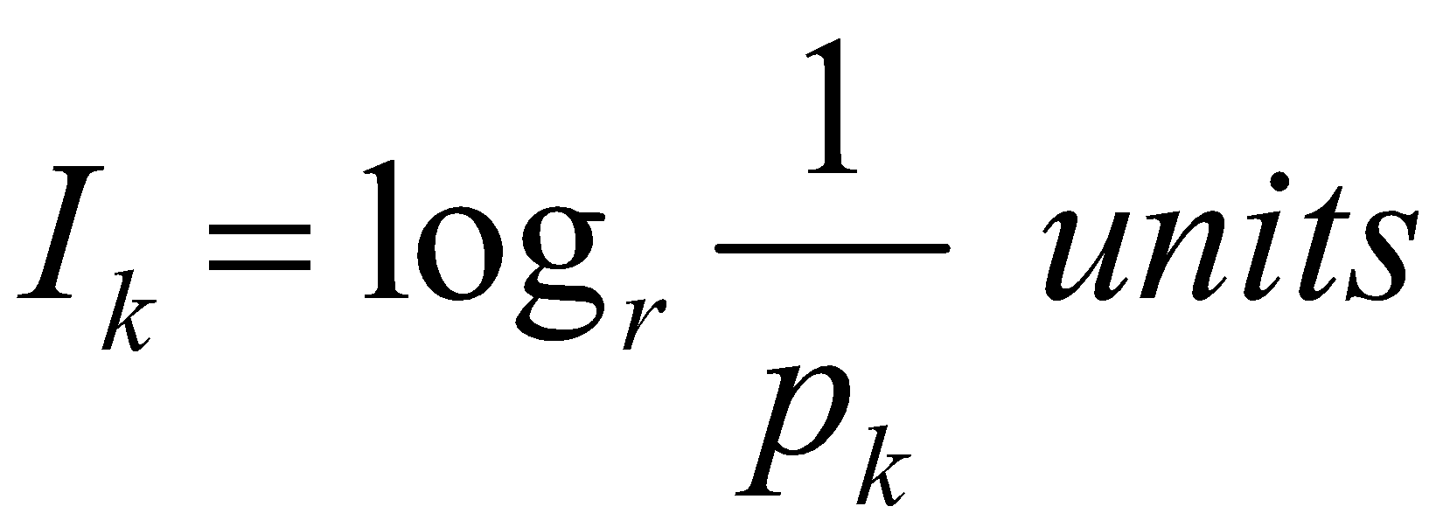
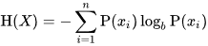
Measure of Information and Entropy
The amount of information (surprise element) conveyed by a message is inversely proportional to its probability of occurrence. That is
The mathematical operator satisfies above properties is the logarithmic operator.
Entropy of discrete random variable X={x₁, x₂…x_{n}}
since: log₂(1/P(event))= -log₂P(event)
As uncertainty increases, entropy increases
Entropy across all values

Slide 5
Entropy in binary classification
Entropy measures the impurity of a collection of examples. It depends from the distribution of the random variable p.
S is a collection of training examples
p₊ the proportion of positive examples in S
p– the proportion of negative examples in S
Entropy (S) ≡ – p₊ log₂ p₊ – p–log₂ p– [0 log₂0 = 0]
Entropy ([14+, 0–]) = – 14/14 log₂ (14/14) – 0 log₂ (0) = 0
Entropy ([9+, 5–]) = – 9/14 log₂ (9/14) – 5/14 log₂ (5/14) = 0.94
Entropy ([7+, 7– ]) = – 7/14 log₂ (7/14) – 7/14 log₂ (7/14) = 1/2 + 1/2 = 1
Note: the log of a number < 1 is negative, 0 ≤ p ≤ 1, 0 ≤ entropy ≤ 1
Notes:
S=[9+, 5-] una collezione di esempi di cui 9 positivi e 5 negativi

Slide 6
Information gain as entropy reduction
Information gain is the expected reduction in entropy caused by partitioning the examples on an attribute.
The higher the information gain the more effective the attribute in classifying training data.
Expected reduction in entropy knowing A
Gain(S, A) = Entropy(S) − Σ Entropy(S_{v})
v ∈ values(A)
values(A) possible values for A
S_{v} subset of S for which A has value v
|Sv|
|S|
Notes:
La riduzione in entropia attesa partizionando sui valori dell’ attributo A

Slide 7
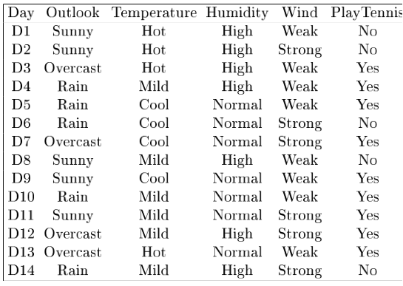
Example: Information gain
Let
Values(Wind) = {Weak, Strong}
S = [9+, 5−]
|S| = 14
S_{Weak} = [6+, 2−]
| S_{weak}| = 8
S_{Strong} = [3+, 3−]
| S_{strong}| = 6
Information gain due to knowing Wind:
Gain(S, Wind) = Entropy(S) − 8/14 Entropy(S_{Weak}) − 6/14 Entropy(S_{Strong})
= 0.94 − 8/14 × 0.811 − 6/14 × 1.00
= 0.048

Slide 8
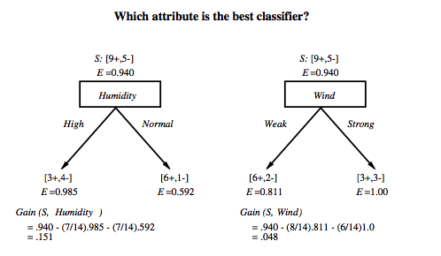
Which attribute is the best classifier?

Slide 9
First step
Which attribute should be tested at the root?
Which attribute should be tested at the root?
Gain(S, Outlook) = 0.246
Gain(S, Humidity) = 0.151
Gain(S, Wind) = 0.048
Gain(S, Temperature) = 0.029
Outlook provides the best prediction for the target
Lets grow the tree
add to the tree a successor for each possible value of Outlook
partition the training samples according to the value of Outlook

Slide 10
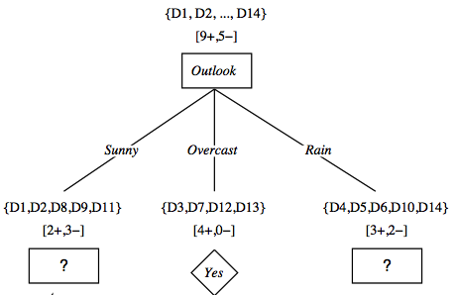
After first step

Slide 11
Second step
Working on Outlook=Sunny node:
Gain(S_{Sunny}, Humidity) = 0.970 − 3/5 × 0.0 − 2/5 × 0.0 = 0.970
Gain(S_{Sunny}, Wind) = 0.970 − 2/5 × 1.0 − 3.5 × 0.918 = 0 .019
Gain(S_{Sunny}, Temp.) = 0.970 − 2/5 × 0.0 − 2/5 × 1.0 − 1/5 × 0.0 = 0.570
Humidity provides the best prediction for the target
Lets grow the tree
add to the tree a successor for each possible value of Humidity
partition the training samples according to the value of Humidity

Slide 12
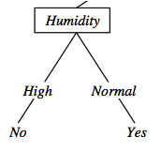
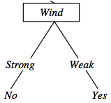
Second and third steps
{D1, D2, D8}
No
{D9, D11}
Yes
{D4, D5, D10}
Yes
{D6, D14}
No

Slide 13
An alternative measure: Gain Ratio
c |S_{i} | |S_{i} |
SplitInformation(S, A) ≡ − Σ log₂ i=1 |S | |S |
S_{i} are the sets obtained by partitioning on value i of A
SplitInformation measures the entropy of S with respect to the values of A.
The more uniformly dispersed the data the higher it is.
Gain(S, A)
GainRatio(S, A) ≡
SplitInformation(S, A)
GainRatio penalizes attributes that split examples in many small classes such as Date.
Let |S |=n, Date splits examples in n classes
SplitInformation(S, Date)= −[(1/n log₂ 1/n)+…+ (1/n log₂ 1/n)]= −log₂1/n =log₂n
Compare with A, which splits data in two even classes:
SplitInformation(S, A)= − [(1/2 log₂1/2)+ (1/2 log₂1/2) ]= − [− 1/2 −1/2]=1
Notes:
2^{-x} = 1/2^{x}

Slide 14
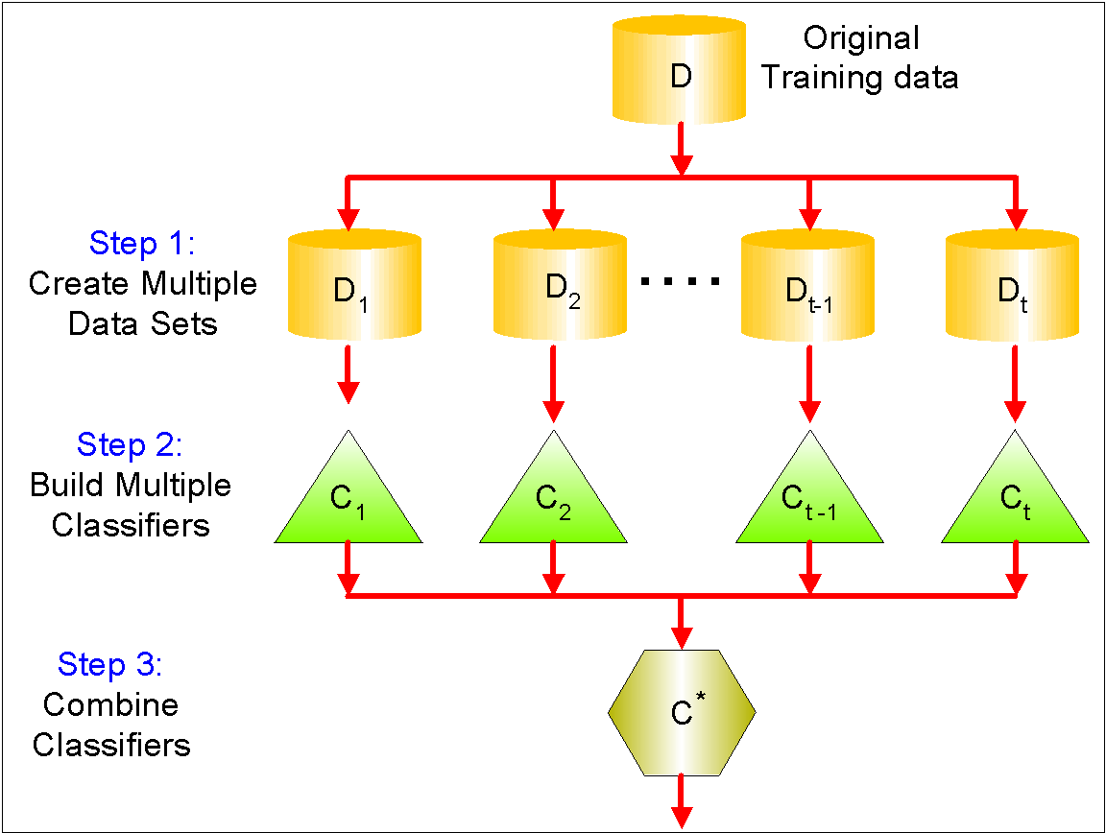
Ensemble Methods
Use multiple learning algorithms to obtain better predictive performance than could be obtained from any of the constituent learning algorithms alone
Construct a set of classifiers from the training data
Predict class label of test records by combining the predictions made by multiple classifiers
Tend to reduce problems related to overfitting of the training data.

Slide 15
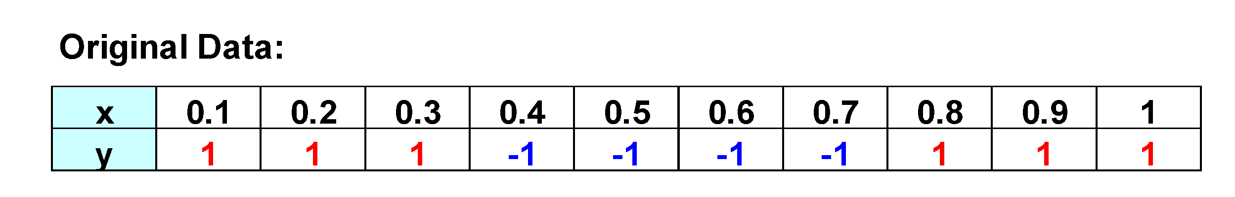
Bagging Example
Consider this one-dimensional dataset
Classifier is a decision stump
Decision rule: x ≤ k versus x > k
Split point k is chosen based on entropy
x ≤ k
True
False
y_{left}
y_{right}

Slide 16
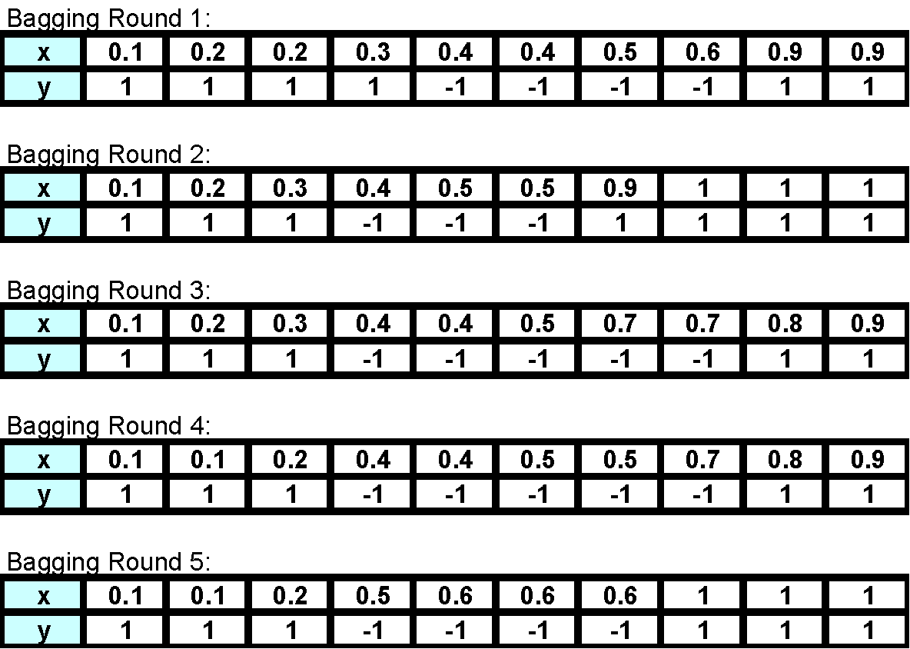
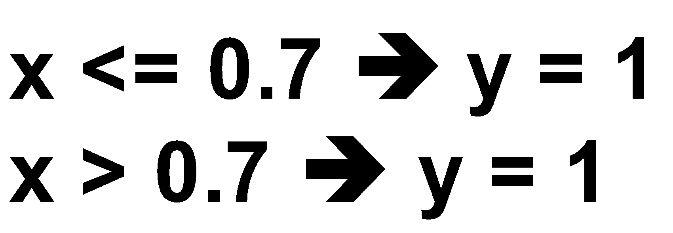
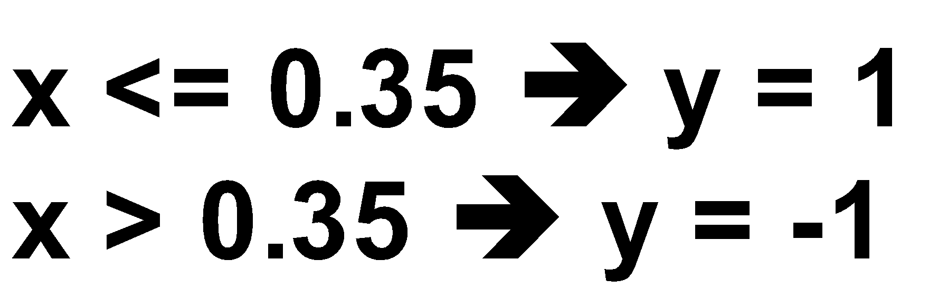
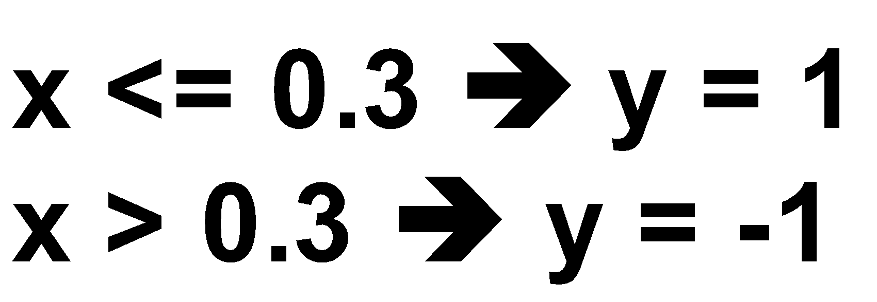
Bagging Example

Slide 17

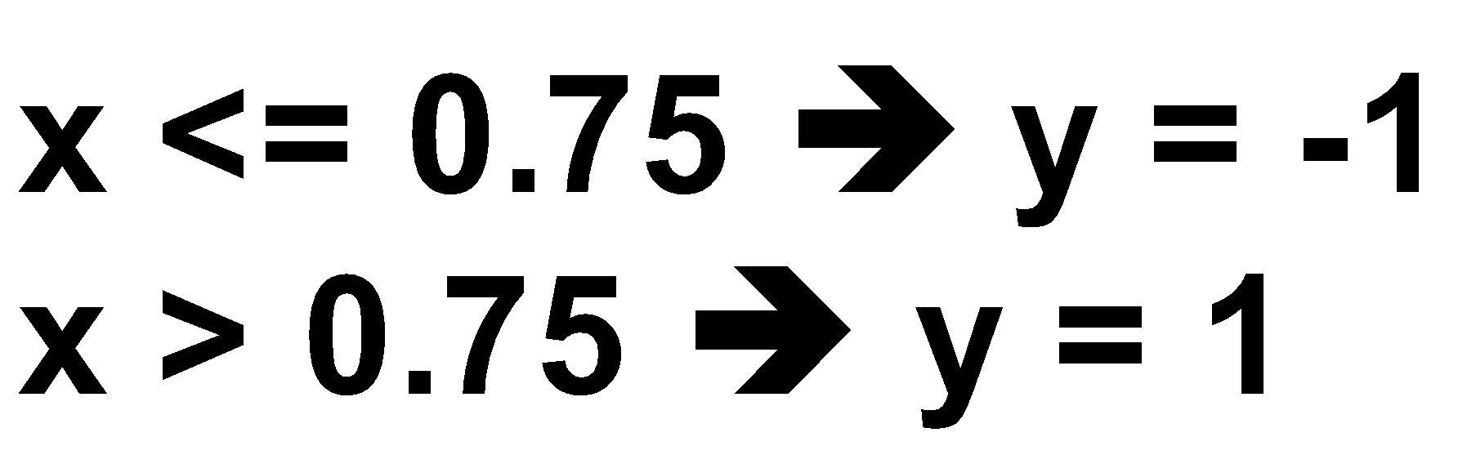
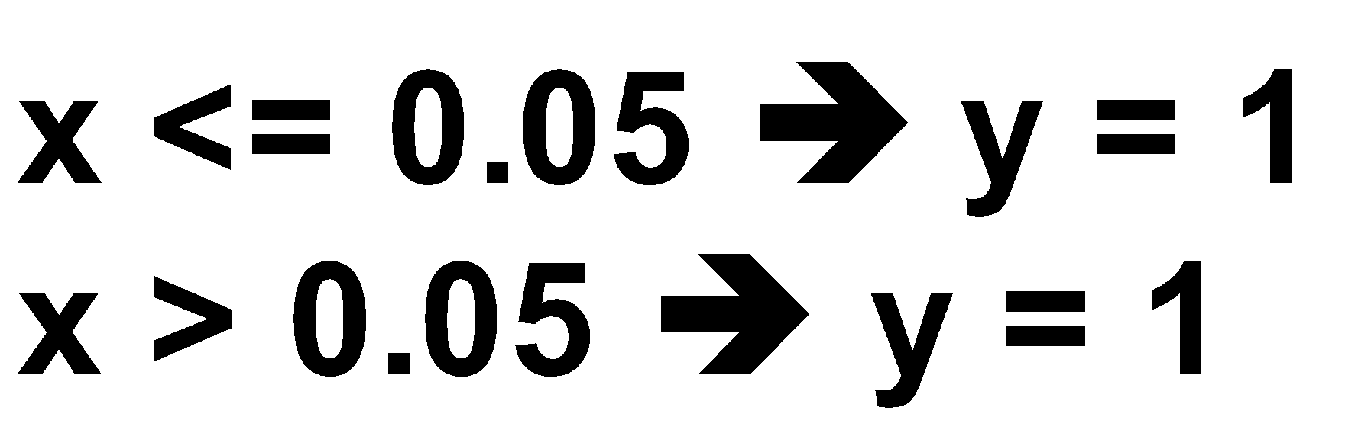
Bagging Example

Slide 18
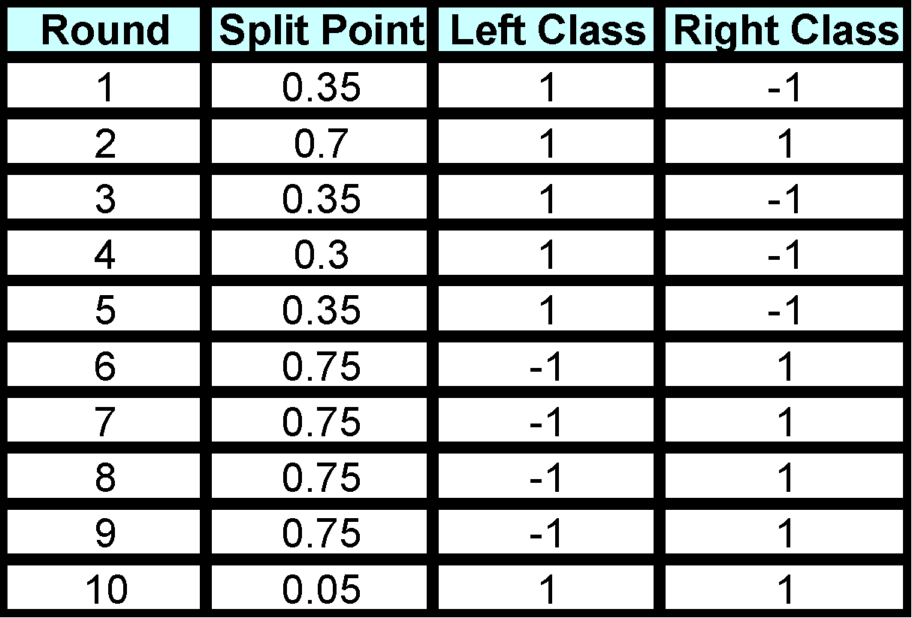
Bagging Example
Summary of Training set

Slide 19
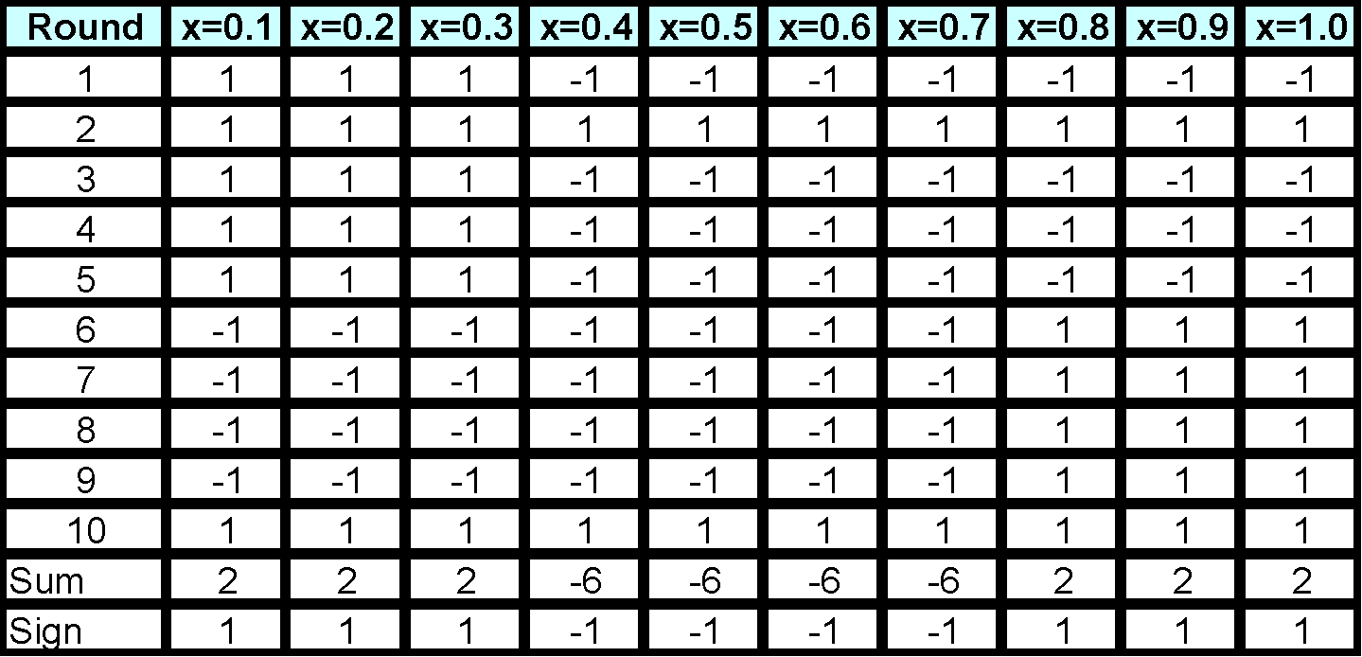
Bagging Example
Assume test set is the same as the original data
Use majority vote to determine class of ensemble classifier
Predicted Class

Slide 20
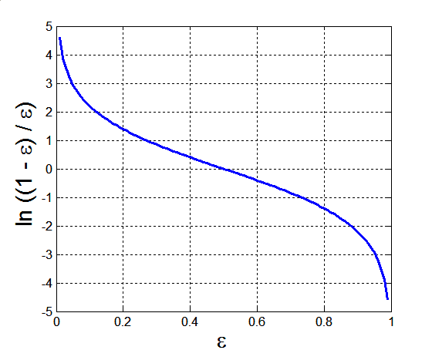
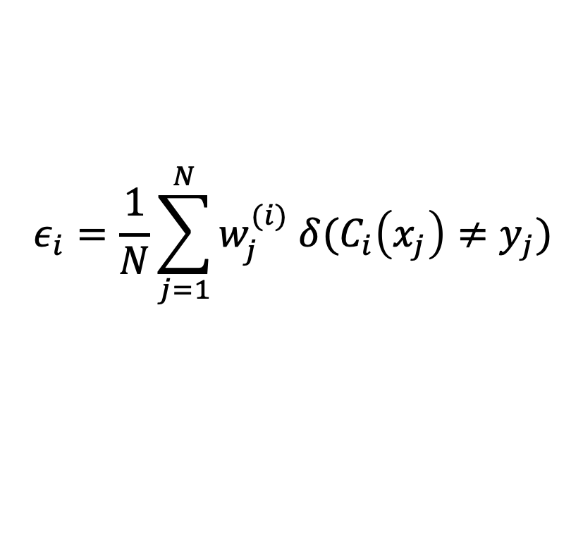
AdaBoost
Base classifiers: C₁, C₂, …, C_{T}
Error rate of a base classifier:
Importance of a classifier

Slide 21
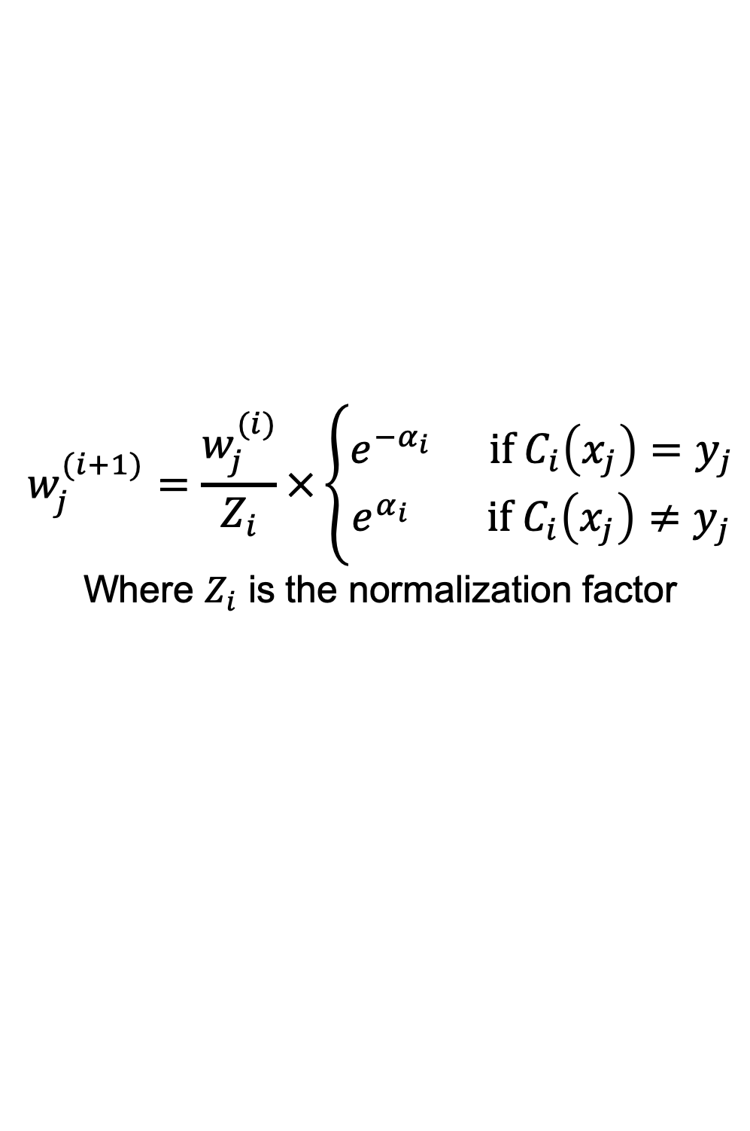
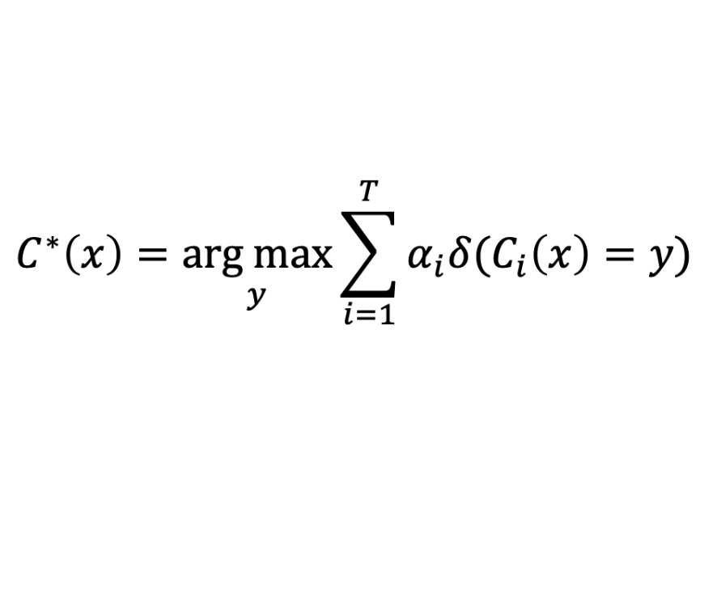
AdaBoost Algorithm
Weight update for j-th training data at i-th step
If any intermediate rounds produce error rate higher than 50%, the weights are reverted back to 1/n and the resampling procedure is repeated
Classification
Equation 1

Slide 22
AdaBoost Example
Consider this one dimensional dataset
Classifier is a decision stump
Decision rule: x ≤ k versus x > k
Split point k is chosen based on entropy
x ≤ k
True
False
y_{left}
y_{right}

Slide 23
AdaBoost Example
Training sets for the first 3 boosting rounds
Summary:

Slide 24
AdaBoost Example
Weights
Classification
Predicted Class

Slide 25
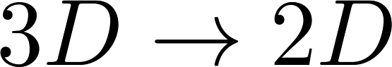
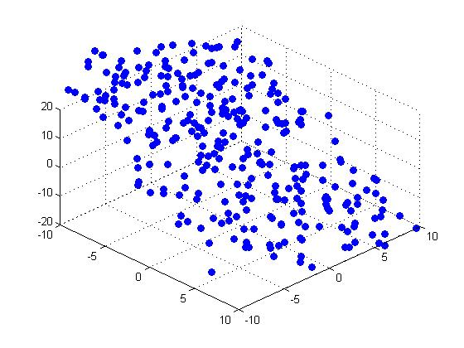
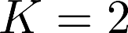
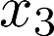
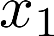
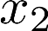
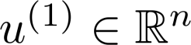
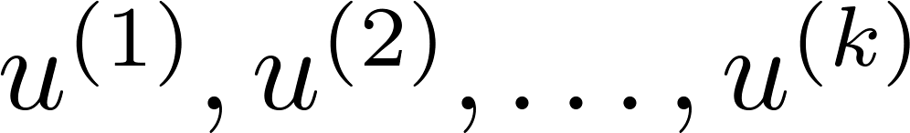
PCA Problem Formulation
Reduce from 2-dimension to 1-dimension: Find a direction (a vector )
onto which to project the data so as to minimize the projection error.
Reduce from n-dimension to k-dimension: Find vectors
onto which to project the data, so as to minimize the projection error.
Andrew Ng
Notes:
Change numbers to LATEX as well

Slide 26
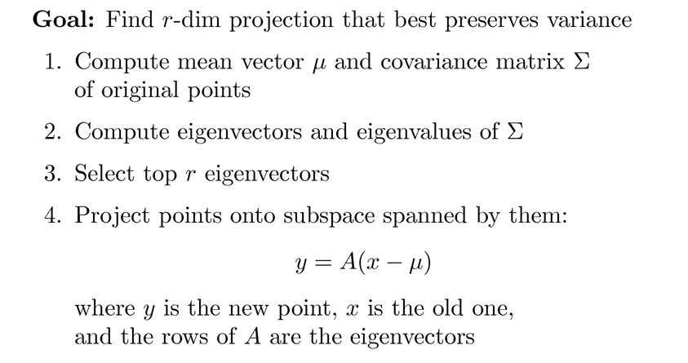
Principal Component Analysis

Slide 27
Covariance
Variance and Covariance:
Measure of the “spread” of a set of points around their center of mass(mean)
Variance:
Measure of the deviation from the mean for points in one dimension
Covariance:
Measure of how much each of the dimensions vary from the mean with respect to each other
Covariance is measured between two dimensions
Covariance sees if there is a relation between two dimensions
Covariance between one dimension is the variance

Slide 28
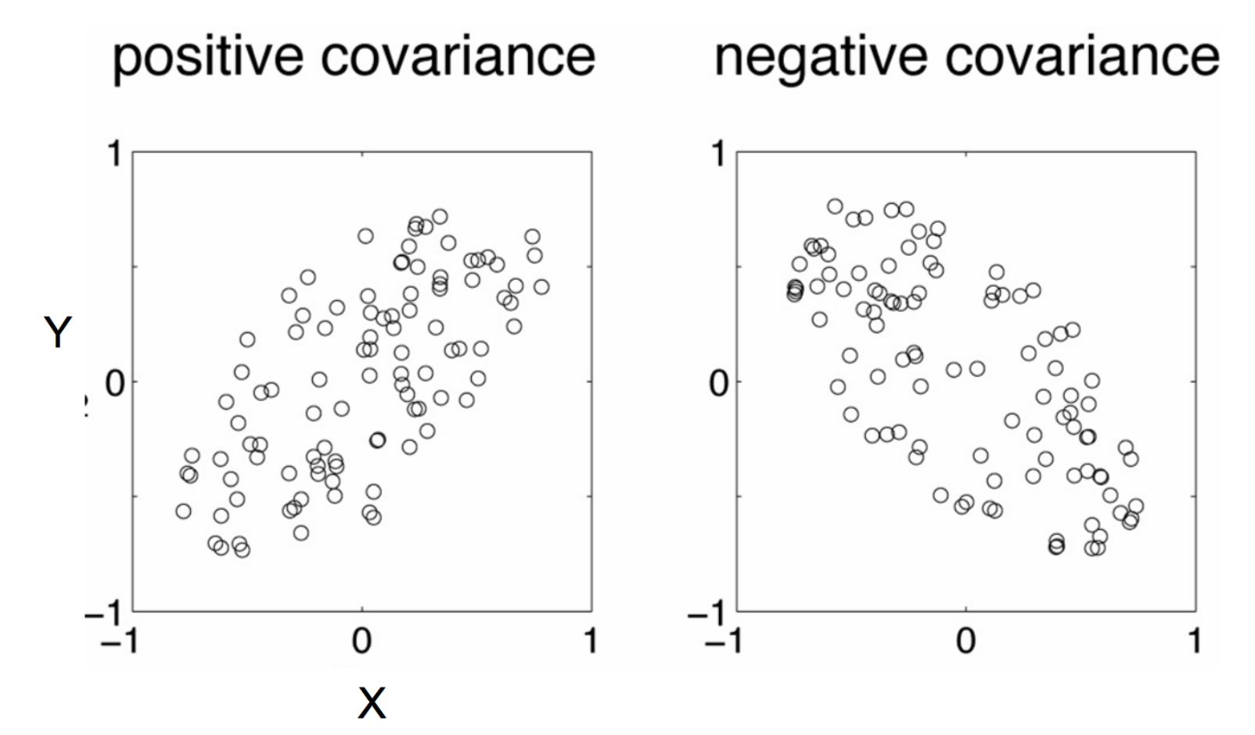
Negative: While one increase the other decrease
Positive: Both dimensions increase or decrease together

Slide 29
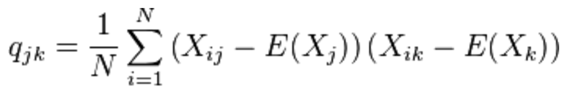
Covariance
Used to find relationships between dimensions in high dimensional data sets
The Sample mean

Slide 30
Eigenvector and Eigenvalue
Ax = λx
A: Square Matrix
λ: Eigenvector or characteristic vector
X: Eigenvalue or characteristic value
The zero vector can not be an eigenvector
The value zero can be eigenvalue

Slide 31
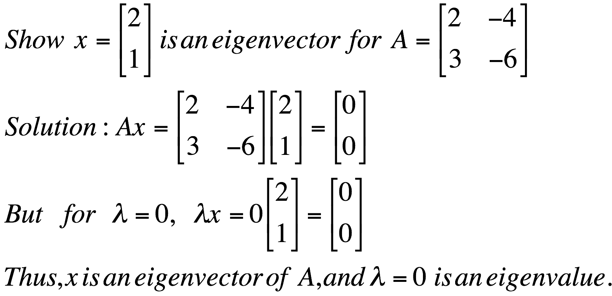
Eigenvector and Eigenvalue
Ax = λx
A: Square Matrix
λ: Eigenvector or characteristic vector
X: Eigenvalue or characteristic value
Example

Slide 32

Eigenvector and Eigenvalue
Ax - λx = 0
(A – λI)x = 0
Ax = λx
B = A – λI
Bx = 0
If we define a new matrix B:
x = B⁻¹0 = 0
BUT! an eigenvector cannot be zero!!
If B has an inverse:
x will be an eigenvector of A if and only if B does not have an inverse, or equivalently det(B)=0 :
det(A – λI) = 0

Slide 33
Eigenvector and Eigenvalue
Example 1: Find the eigenvalues of
two eigenvalues: −1, − 2
Note: The roots of the characteristic equation can be repeated. That is, λ₁ = λ₂ =…= λ_{k}. If that happens, the eigenvalue is said to be of multiplicity k.
Example 2: Find the eigenvalues of
λ = 2 is an eigenvector of multiplicity 3.

Slide 34
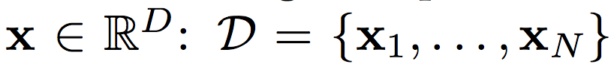
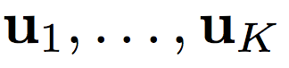
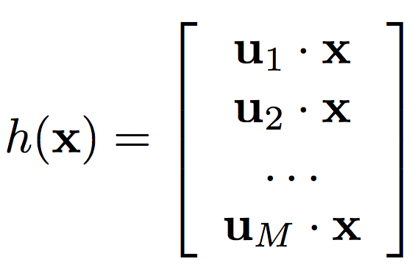
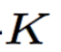
Principal Component Analysis
Input:
Set of basis vectors:
Summarize a D dimensional vector X with K dimensional feature vector h(x)

Slide 35
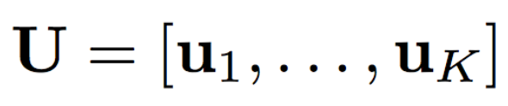
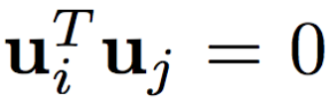
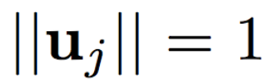
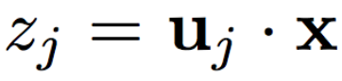
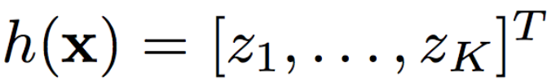
Principal Component Analysis
Basis vectors are orthonormal
New data representation h(x)

Slide 36
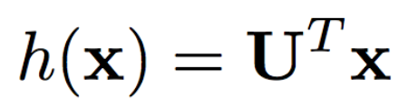
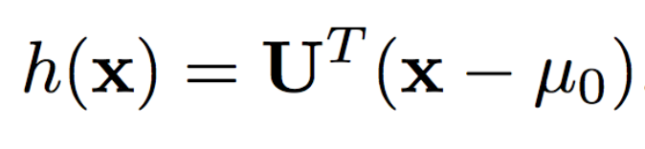
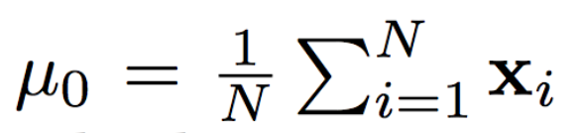
Principal Component Analysis
New data representation h(x)
Empirical mean of the data

Slide 37
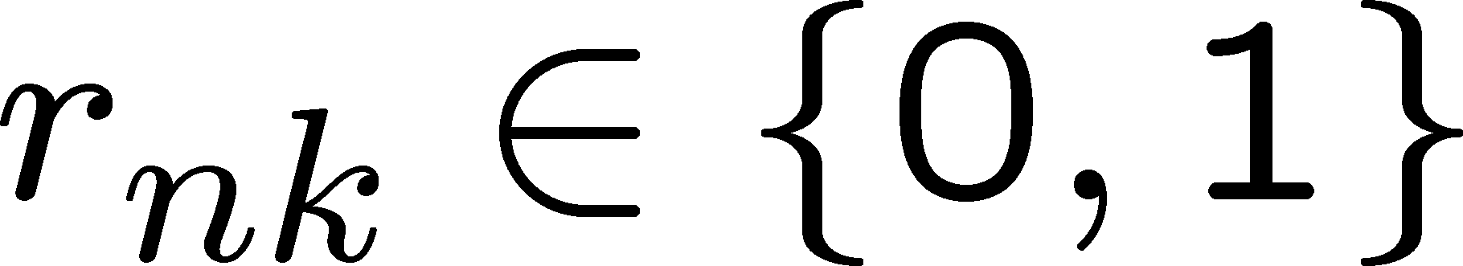
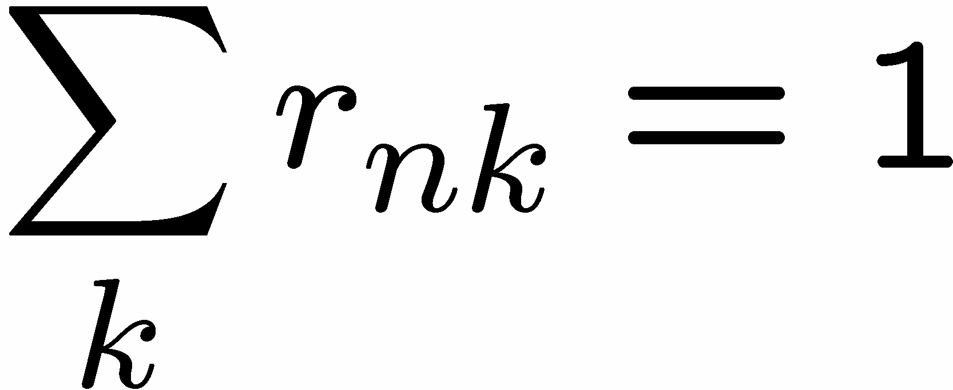
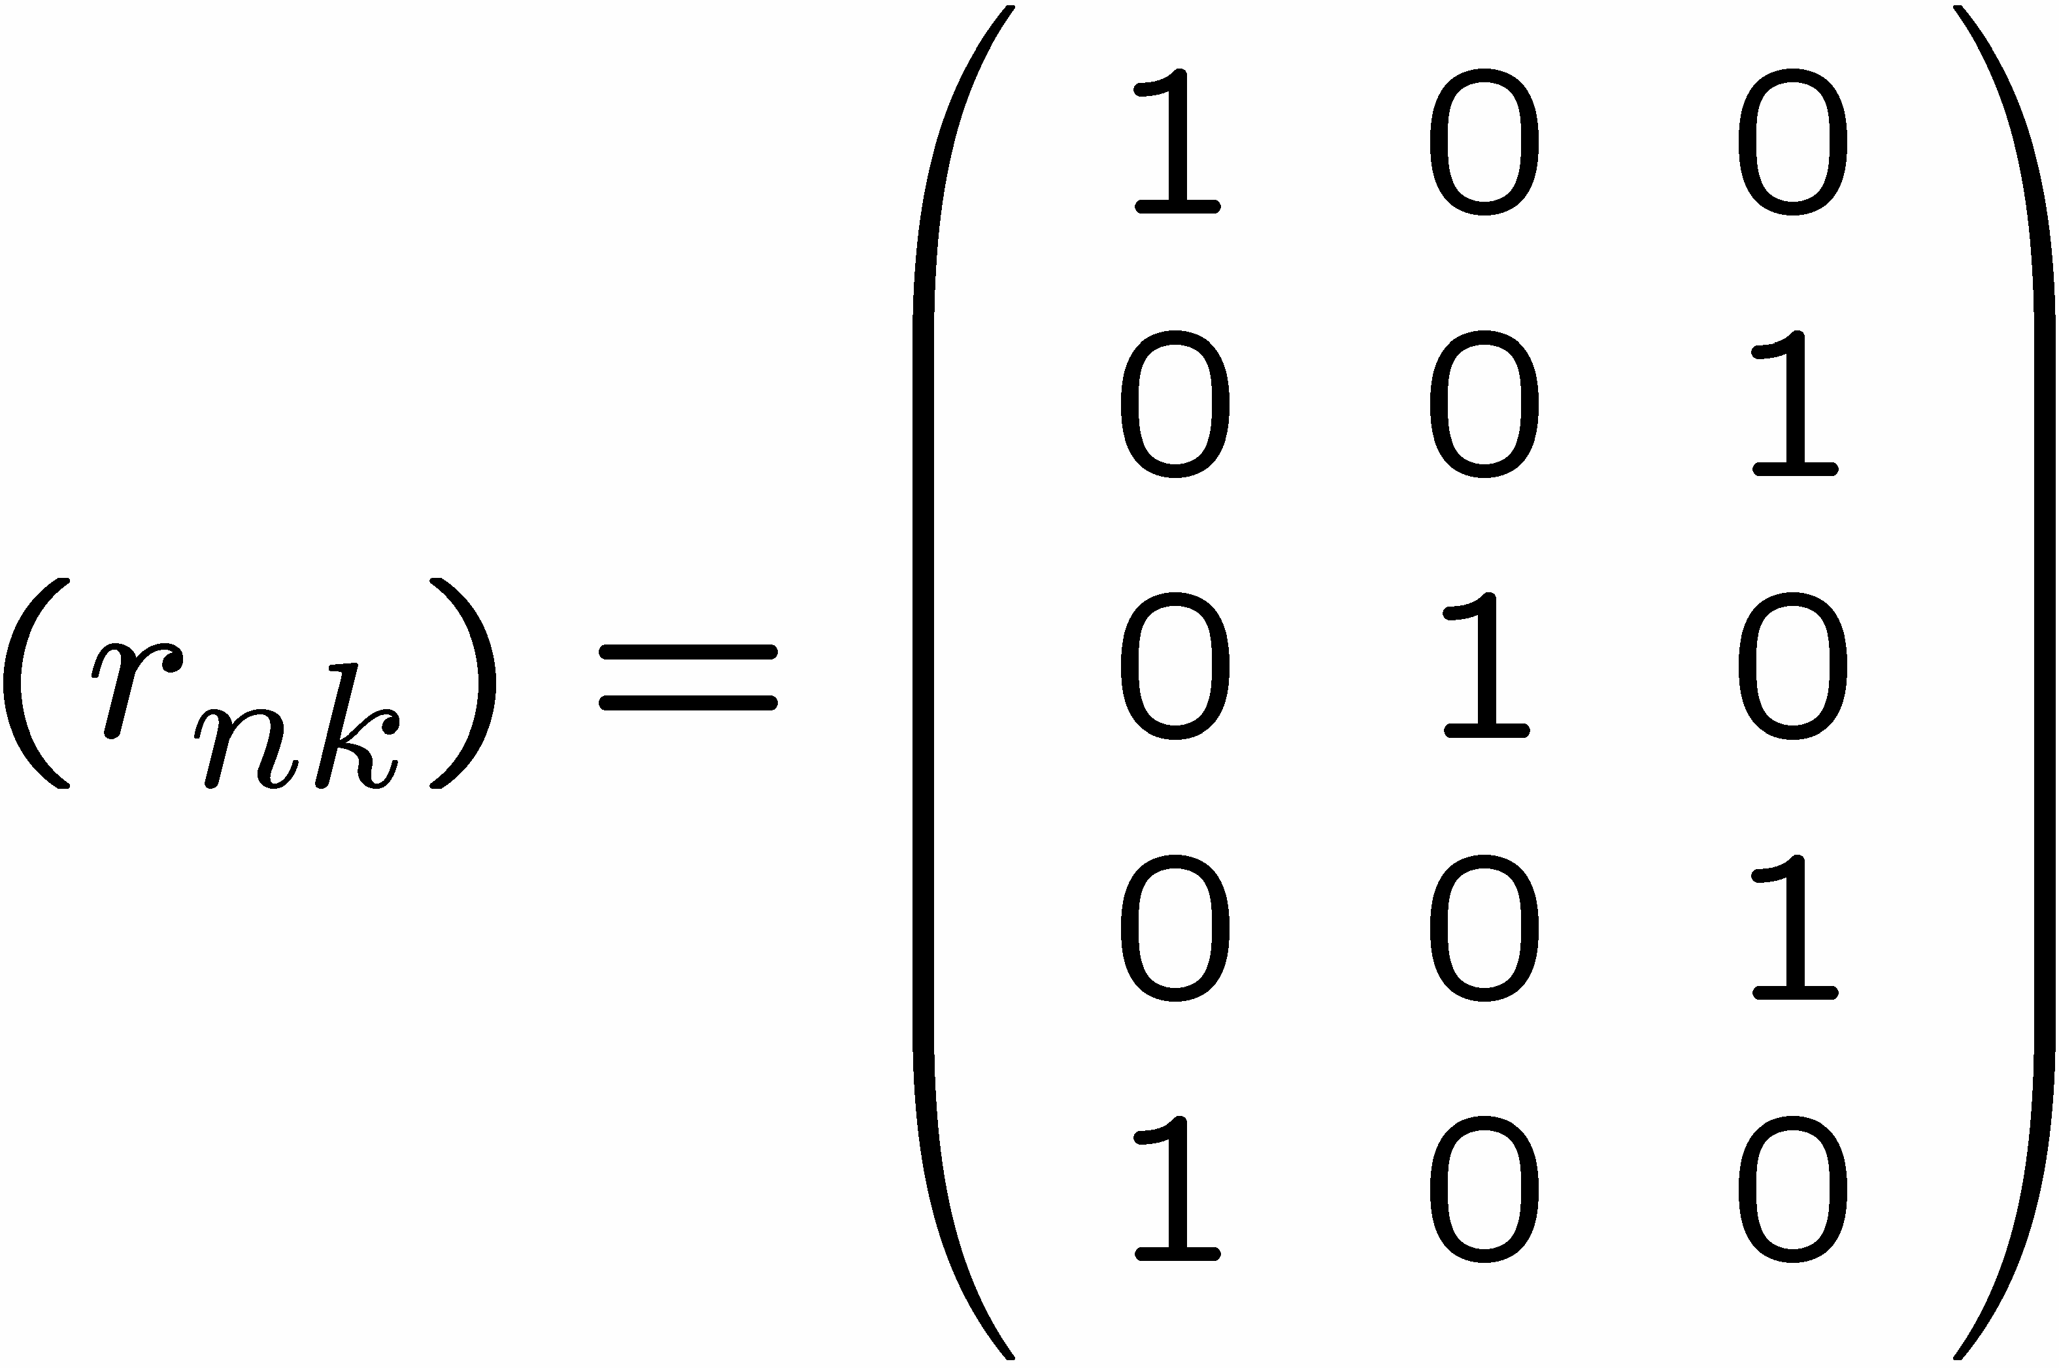
1 of K coding mechanism
For each data point x_{n}, we introduce a set of binary indicator variables
such that
where k =1,...,K describing which of the K clusters the data point x_{n} is assigned to, so that if data point x_{n} is assigned to cluster k then r_{nk} =1, and r_{nj} =0 for j not equal to k.
Example: 5 data points and 3 clusters

Slide 38
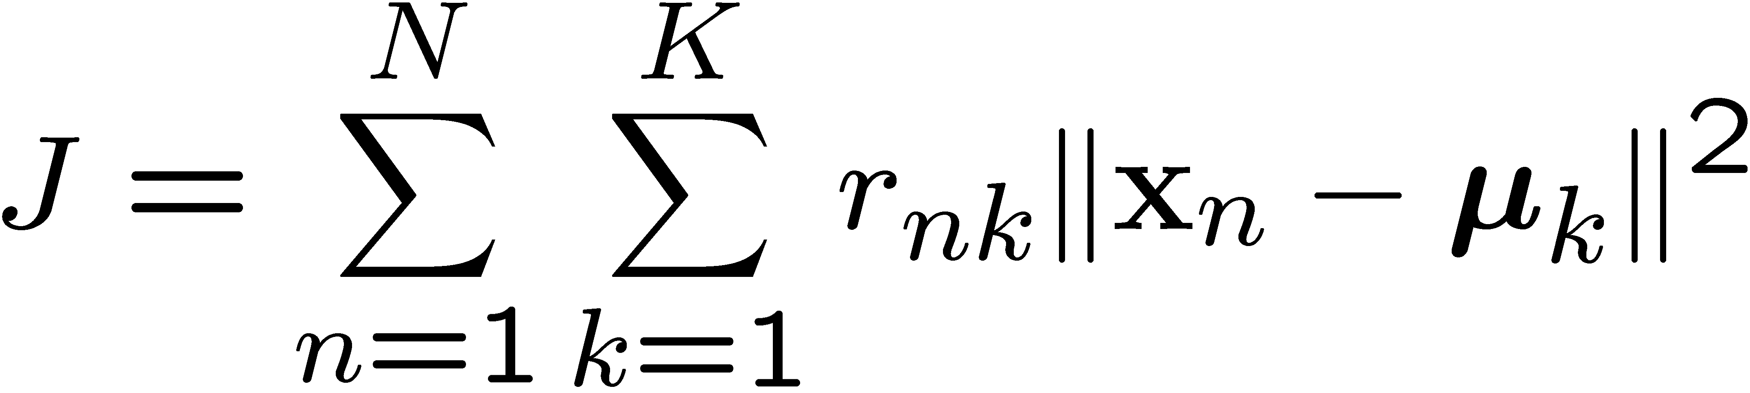
K-means Cost Function
data
responsibilities
prototypes

Slide 39




Minimizing the Cost Function
E-step: minimize J w.r.t.
M-step: minimize J w.r.t
Convergence guaranteed since there is a finite number of possible settings for the responsibilities

Slide 40


Gaussian Distribution
Example: the data is the income of all people in country G
Experience has shown that this data follows a Gaussian (Normal) distribution
Reminder: Normal distribution:
$μ$= mean, $σ$= standard deviation
$$P\left(x\right)= \frac{1}{\sqrt{2π}σ}e^{−\frac{{\left(x−μ\right)}^{2}}{2σ^{2}}}$$

Slide 41





Maximum Likelihood Estimation (MLE)
The probability $P(X|θ)$as a function of $θ$is called the Likelihood function
It is usually easier to work with the Log-Likelihood function
Maximum Likelihood Estimation
Find parameters $μ, σ$that maximize $LL(θ)$
$$L(θ)=\prod_{i=1}^{n}{\frac{1}{\sqrt{2π}σ}e^{−\frac{{\left(x_{i}−μ\right)}^{2}}{2σ^{2}}}}$$
$$LL\left(θ\right)=−\sum_{i=1}^{n}{\frac{{\left(x_{i}−μ\right)}^{2}}{2σ^{2}}−\frac{1}{2}n\log{2π}−n\log{σ}}$$
$$μ= \frac{1}{n}\sum_{i=1}^{n}{x_{i}=μ_{X}}$$
$$σ^{2}= \frac{1}{n}\sum_{i=1}^{n}{{{(x}_{i}−μ)}^{2} }=σ_{X}^{2}$$
Sample Mean
Sample Variance

Slide 42

Mixture Model
Our model has the following parameters
$$Θ=(π_{G},π_{C},μ_{G},μ_{C}, σ_{G},σ_{C })$$
For value $x_{i}$, we have:
$$P\left(x_{i}|Θ\right)=π_{G}P\left(x_{i} | θ_{G}\right)+π_{C}P(x_{i}|θ_{C})$$
For all values $X = \left(x_{1},…,x_{n}\right)$
$$P\left(X|Θ\right)= \prod_{i=1}^{n}{P(x_{i}|Θ)}$$
We want to estimate the parameters that maximize the Likelihood of the data
Mixture probabilities
Distribution Parameters

Slide 43

Mixture Models
Once we have the parameters $Θ=(π_{G},π_{C},μ_{G},μ_{C}, σ_{G},σ_{C})$ we can estimate the membership probabilities $P\left(G | x_{i}\right)$ and $P\left(C | x_{i}\right)$for each point $x_{i}$:
This is the probability that point $x_{i}$ belongs to the country G or C population (cluster)
$$P\left(G | x_{i}\right)= \frac{P\left(x_{i} | G\right)P(G)}{P\left(x_{i} | G\right)P\left(G\right)+P\left(x_{i} | C\right)P(C)} =\frac{P\left(x_{i} | G\right)π_{G}}{P\left(x_{i} | G\right)π_{G}+P\left(x_{i} | C\right)π_{C}}$$

Slide 44








EM (Expectation Maximization) Algorithm
Initialize the values of the parameters in $Θ$to some random values
Repeat until convergence
E-Step: Given the parameters $Θ$estimate the membership probabilities $P\left(G | x_{i}\right)$ and $P\left(C | x_{i}\right)$
M-Step: Compute the parameter values that (in expectation) maximize the data likelihood
$$π_{G}=\frac{1}{n}\sum_{i=1}^{n}{P(G|x_{i})}$$
$$π_{C}=\frac{1}{n}\sum_{i=1}^{n}{P(C|x_{i})}$$
Fraction of population in G,C
$$μ_{C}= \sum_{i=1}^{n}{\frac{P\left(C | x_{i}\right)}{n{∗π}_{C}}x_{i}}$$
$$μ_{G}= \sum_{i=1}^{n}{\frac{P\left(G | x_{i}\right)}{n{∗π}_{G}}x_{i}}$$
MLE Estimates
if $π$’s were fixed
$$σ_{C}^{2}= \sum_{i=1}^{n}{\frac{P\left(C | x_{i}\right)}{n{∗π}_{C}}{\left(x_{i}−μ_{C}\right)}^{2}}$$
$$σ_{G}^{2}= \sum_{i=1}^{n}{\frac{P\left(G | x_{i}\right)}{n{∗π}_{G}}{\left(x_{i}−μ_{G}\right)}^{2}}$$

Slide 45

An Example
x₁ x₂ Output
Consider a perceptron with output 0/1 as shown
0
0
0
x₀=+1
x₁
x2 w₂ =+20
w₀ =-30
0
1
0
w₁ =+20
σ(w ^{T} x )
1
0
0
1
1
1
Represents a linear decision boundary
x₂
This perceptron computes logical AND
w₀=-10 gives logical OR
w₀=10, w₁=-20 with single input gives logical NOT
XOR is not possible
+ve region
−30 + 20x₁ + 20x₂ = 0
-ve region
x₁

Slide 46

An Example
Design a perceptron for
We have following four equations
w₀ + w₁ × (0) + w₂ × (0) < 0 (1)
w₀ + w₁ × (0) + w₂ × (1) < 0 (2)
w₀ + w₁ × (1) + w₂ × (0) ≥ 0 (3)
w₀ + w₁ × (1) + w₂ × (1) < 0 (4)
X₁ | x₂ | Classification
0 | 0 | 0
0 | 1 | 0
1 | 0 | 1
1 | 1 | 0
By (1) w₀ < 0 so let w₀ = −1
Let us assume following
By (2) w₀+w₂<0 so let w₂ = −1
+1
By (3) w₀+w₁≥0 so let w₁ = 1.5
w₀
By (4) w₀+w₁+w₂<0 that is valid
x
w₁
σ(w ^{T} x )
So (w₀, w₁, w₂) = (−1, −1, 1.5)
1
Other possibilities are also there
x
2
w₂

Slide 47



Perceptron Training (delta rule)
Delta rule converges to a best-fit approximation of the target
Uses gradient descent
Consider un-thresholded perceptron, i.e., output
Training error is defined as
Gradient would specify direction of steepest increase
Weights can be learned as
It can be seen that

Slide 48
Perceptron Training (delta rule)
Algorithm: Gradient Descent (D,η)
1 Initialize w_{i} with random weights
2 repeat
3
4
5
6
For each w_{i} , initialize δw_{i} = 0
for each training example d ∈ D do
Compute output o using model for d whose target is t
For each w_{i} , update δw_{i} = δw_{i} + η(t−o)x_{i}
7
For each w_{i} , set w_{i} = w_{i} + δw_{i}
8 until termination condition is met;
9 return w
A date item d ∈ D, is supposed to be multidimensional d = (x₁, x₂, ..., x_{n}, t )
Algorithm converges toward the minimum error hypothesis.
Linear programming can also be an approach

Slide 49

Neural Network
When neurons are interconnected in layers
Input Layer
Hidden Layer 1
Hidden Layer 2
Output Layer
Number of layers may differ
Nodes in each intermediate layers may also differ
Multiple output neurons are used for different class
Two levels deep NN can represent any Boolean function

Slide 50
An Example
Design a neural network for
x₁ | X₂ | Classification
0 | 0 | 0
0 | 1 | 0
1 | 0 | 1
1 | 1 | 0
x₁ | X₂ | x¯₂ | (x₁)AND(x¯₂)
0 | 0 | 1 | 0
0 | 1 | 0 | 0
1 | 0 | 1 | 1
1 | 1 | 0 | 0
x₀=+1
10
-30
x₁
0
20
-20
x₂
20
This arrangement is mostly avoided, as training is more challenging

Slide 51

Width of a single-layer Boolean MLP
How many neurons in one hidden layer needed?
YZ
WX
00
01
11
10
10
11
01
YZ
_{UV} 00
00
01 11 10
Can be generalized: Will require 2^{N-1} perceptrons in hidden layer - Exponential in N
How many hidden nodes if multiple hidden layers are used?

Slide 52
Neural Network Design
Output
x2
(2,3)
-
(5,3)
4
+ + +
+ + +
-
-
+1
-1
-1
+1
(2,1)
(5,1)
-
2
5
1
3
x1
1
0
0
1
0
1
1
0
Activation function:
Output = 1 if total weighted input >= threshold T
= -1 otherwise
Other choices of weights and thresholds are possible
x1
x2

Slide 53


Neuron
Neuron uses nonlinear activation functions (sigmoid , tanh, ReLU, softplus etc.) at the place of thresholding
+1
sigmoid(x) tanh(x) softplus(x)
w₀
x₁
w₁
act(w ^{T} x )
1
0
x
x₂
w₂

Slide 54



Multilayer Networks and Backpropagation
Single perceptron can only express linear decision surface
We need units whose output is a nonlinear function of its inputs AND is also differentiable (Use Neuron not Perceptron)
Backpropagation algorithm learns the weights for a fixed set of units and interconnection
It employs gradient descent to minimize the error between the network output values and the target values for these outputs
Let Error function is redefined as

Slide 55


Backpropagation (for 2 layers)
Algorithm: Backpropagation(D,η,n_{in},n_{out} ,n_{hidden})
1 Create the feedforward network with n_{in} , n_{out} , n_{hidden} layers
2 Randomly initialize weights to small values ∈ [−0.05, +0.05]
3 repeat
4
5
6
7
8
for each ∈ D do
o_{u} = get output from network ∀ unit u
δ_{k} = o_{k} (1 − o_{k} )(t_{k} − o_{k} ) for all output unit k
δ_{h} = o_{h} (1 − o_{h} )
(w δ ) for all hidden unit h
w_{ji} = w_{ji} + ∆w_{ji} where ∆w_{ji} = ηδ_{j} x_{ji}
9 until converge;
Recall error function is
For a single training example
Weight w_{ji} is updated by adding

Slide 56

Parameter Updates in Deep Networks
Leaky ReLU activation function that generates output = input, if input >= 0, and 0.1 * input if output < 0. What will be the weights w₃₁ and w₁₂ in the next iteration with learning rate = 0.1, x1=x2=1, and target output 0?
Assume, squared difference between the actual and target output is used as the loss function, derivative of activation function = 0 at input = 0, and zero bias at all nodes.
y
w₃₁=0.67
w₃₂=0.33
w₁₂=0.75
w₁₁=0.25
w₂₂=0.25
w₂₁=0.75
x1
x2
. Assume, error E = 0.5*(t-y)² . For x1=x2=1, actual output y = 1 and output of hidden nodes are o₁=o₂=1. Target output t = 0 as specified in the question. Note $y=w_{31}o_{1}+w_{32}o_{2}$

Slide 57


Parameter Updates in Deep Networks
y
. Assume, error E = 0.5*(t-y)² . For x1=x2=1, actual output y = 1 and output of hidden nodes are o₁=o₂=1. Target output t = 0 as specified in the question. Note
$$y=w_{31}o_{1}+w_{32}o_{2}$$
$$net_{3}=w_{31}o_{1}+w_{32}o_{2}$$
w₃₁=0.67
w₃₂=0.33
w₁₂=0.75
w₁₁=0.25
w₂₂=0.25
w₂₁=0.75
x1
x2
$Δw_{31}= −\frac{ηδE}{δw_{31}}= −\frac{ηδE}{δy}∗\frac{δy}{δnet_{3}}∗\frac{δnet_{3}}{δw_{31}}=η\left(t−y\right)∗o_{1}= −0.1$.
Thus, value of w₃₁ in the next iteration will be
$w_{31}+ Δw_{31}=0.67−0.1=0.57$.

Slide 58


Parameter Updates in Deep Networks
y
$$net_{3}=w_{31}o_{1}+w_{32}o_{2}$$
$$y={net_{3}= w}_{31}o_{1}+w_{32}o_{2}$$
$$net_{1}=w_{11}x_{1}+w_{12}x_{2}$$
$$o_{1}={net_{1}= w}_{11}x_{1}+w_{12}x_{2}$$
w₃₁=0.67
w₃₂=0.33
w₁₂=0.75
w₁₁=0.25
w₂₂=0.25
w₂₁=0.75
x1
x2
$$Δw_{12}= −\frac{ηδE}{δw_{12}}= −\frac{ηδE}{δy}∗\frac{δy}{δnet_{3}}∗\frac{δnet_{3}}{δo_{1}}∗\frac{δo_{1}}{δnet_{1}}∗\frac{δnet_{1}}{δw_{12}}$$
$=−0.1∗w_{31}∗1∗x_{2}=−0.067$.
Thus, value of w₁₂ in the next iteration will be
$w_{12}+ Δw_{12}=0.75−0.067=0.683$.

Slide 59


Conventions Over The Network
4
5
6
7
8
9
10
11
1
2
3
12
13
xji wji
i th input to unit j (x₉₇ is highlighted)
weight associated with i th input to unit j
the weighted sum of input for unit j
output computed by unit j . Let it be σ(net_{j} )
target output for unit j as specified in training set
set of units in final layer ({12, 13} in this case)
units whose immediate input is the output of unit j
o_{j}
t_{j}
outputs
Downstream(j )
∂E
∂E
∂net
∂E
We are interested in it is
×
j
and therefore,
× x
d
d
d
ji
∂w_{ji}
∂net_{j} ∂w_{ji}
∂net_{j}

Slide 60


Value of ^{∂Ed} for output units
∂net_{j}
Note that o_{j} = σ(net_{j} ) therefore ^{∂oj} is derivative of sigmoid
∂net_{j}
As a result
∂o
j
=
∂σ(net )
= σ(net_{j} )(1 −
σ(net ))
= o_{j} (1 − o_{j} )
j
j
∂net_{j} ∂net_{j}
∂E
d
= −(t_{j} − o_{j} )o_{j} (1 − o_{j} )
∂net_{j}
Term (t_{j} − o_{j} )o_{j} (1 − o_{j} ) is treated as δ_{j}

Slide 61






Value of ^{∂Ed} for hidden units
∂net_{j}

Slide 62
Hyperparameter Tuning
There are many interesting questions for the network
How many layers?
How many units in each layer?
What should be the learning rate?
What is right activation function? etc.
Difficult to answer in the beginning
It is an iterative process
Demo
https://playground.tensorflow.org/

Slide 63




Regularization for NN
As there could be L layers each with their parameters so
where frobenius norm is
How you update the parameter earlier?
Get
dw^{[l]} = (from backpropagation)
then

Slide 64



Regularization for NN (contd…)
With regularization term dw^{[l]} = (from backpropogation) +
Therefore the update is modified to
w^{[l]} = w^{[l]} – α.((from backpropagation) + )
Which is
(from backpropagation)
Due to the factor, this update method is also called weight decay
Our objective here is to penalize the weight matrices being too large

Slide 65







Momentum Update
Plain gradient update With momentum
The momentum method maintains a running average of all gradients until the current step
(k) (k–1) (k–1)
𝑇
=
W
(k) (k–1) (k)
– Typical value is 0.9
The running average steps
Get longer in directions where gradient stays in the same sign
Become shorter in directions where the sign keeps flipping
=

Slide 66







Momentum Update
$Δ$W^{(k-1)}
W^{(k)}
W^{(k-1)}
At any iteration, to compute the current step
First computes the gradient step at the current location
Then adds in the scaled previous step
which is actually a running average
To get the final step
T

Slide 67











Nestorov’s Accelerated Gradient
$Δ$W^{(k-1)}
W^{(k-1)}
W^{(k)}

Slide 68
Smoothing the trajectory
Step | X component | Y component
1 | 1 | +2.5
2 | 1 | -3
3 | 3 | +2.5
4 | 1 | -2
5 | 2 | 1.5
1 2
4
3
5
Simple gradient and acceleration methods still demonstrate oscillatory behavior in some directions
Depends on magic step size parameters
Observation: Steps in “oscillatory” directions show large total movement
In the example, total motion in the vertical direction is much greater than in the horizontal direction
Improvement: Dampen step size in directions with high motion
Using second order term

Slide 69



RMS Prop
This is a variant on the basic mini-batch SGD algorithm
Modified update rule: We want to
scale down updates with large mean squared derivatives of Loss w.r.t. w’s
scale up updates with small mean squared derivatives
Notation
Updates are by parameter
Sum derivative of loss w.r.t any individual parameter w shown as = $\frac{δLoss}{δw}$
The squared derivative is
short-hand notation represents the squared derivative, not the second derivative
The mean squared derivative is a running estimate of the average squared derivative.
We will show this as
w
2 2
w w
w

Slide 70


RMS Prop
Procedure
Maintain a running estimate of the mean squared value of derivatives for each parameter
Scale update of the parameter by the inverse of the root mean squared derivative
Typical parameters $η=0.001, γ=0.9$
k denotes the iteration number.

Slide 71


ADAM: RMSprop with momentum
RMS prop only considers a second-moment normalized version of the current gradient
ADAM utilizes a smoothed version of the momentum-augmented gradient
Considers both first and second moments
Procedure
Maintain a running estimate of the mean derivative for each parameter
Maintain a running estimate of the mean squared value of derivatives for each parameter
Scale update of the parameter by the inverse of the root mean squared derivative
Typical parameters $η=0.001 , δ=0.9 , γ=0.9$99
In initial iterations, smoother trajectory is ensured than in later iterations.

Slide 72
Convolution Operation
Suppose we want to detect edges from an image.
The image will have vertical edges and horizontal edges.
Convolve the image with a kernel or filter to extract both the vertical edges and horizontal edges.
Input Size : n × n
Kernel Size : f × f
Ouput Size : (n − f + 1) × (n − f + 1)

Slide 73
Convolution Operation
Input Image 6 × 6
3 | 0 | 1 | 2 | 7 | 4
1 | 5 | 8 | 9 | 3 | 1
2 | 7 | 2 | 5 | 1 | 3
0 | 1 | 3 | 1 | 7 | 8
4 | 2 | 1 | 6 | 2 | 8
2 | 4 | 5 | 2 | 3 | 9
_{Kernel 3 × 3} Output Image 4 × 4
1 | 0 | -1
1 | 0 | -1
1 | 0 | -1
*
=

Slide 74
Convolution Operation
Input Image 6 × 6
3 | 0 | 1 | 2 | 7 | 4
1 | 5 | 8 | 9 | 3 | 1
2 | 7 | 2 | 5 | 1 | 3
0 | 1 | 3 | 1 | 7 | 8
4 | 2 | 1 | 6 | 2 | 8
2 | 4 | 5 | 2 | 3 | 9
_{Kernel 3 × 3} Output Image 4 × 4
1 | 0 | -1
1 | 0 | -1
1 | 0 | -1
*
=
value = 3(1) + 1(1) + 2(1) + 0(0) + 0(5) + 7(0) + 1(−1) + 8(−1) + 2(−1)
= −5

Slide 75
Convolution Operation
Input Image 6 × 6
3 | 0 | 1 | 2 | 7 | 4
1 | 5 | 8 | 9 | 3 | 1
2 | 7 | 2 | 5 | 1 | 3
0 | 1 | 3 | 1 | 7 | 8
4 | 2 | 1 | 6 | 2 | 8
2 | 4 | 5 | 2 | 3 | 9
_{Kernel 3 × 3} Output Image 4 × 4
-5
1 | 0 | -1
1 | 0 | -1
1 | 0 | -1
*
=
value = 0(1) + 5(1) + 7(1) + 1(0) + 8(0) + 5(0) + 2(−1) + 9(−1) + 5(−1)
= −4

Slide 76
Convolution Operation
Input Image 6 × 6
3 | 0 | 1 | 2 | 7 | 4
1 | 5 | 8 | 9 | 3 | 1
2 | 7 | 2 | 5 | 1 | 3
0 | 1 | 3 | 1 | 7 | 8
4 | 2 | 1 | 6 | 2 | 8
2 | 4 | 5 | 2 | 3 | 9
_{Kernel 3 × 3} Output Image 4 × 4
-5 | -4 | 0 | 8
-10 | -2 | -2 | 3
0 | -2 | -4 | -7
-3 | -2 | -3 | -16
1 | 0 | -1
1 | 0 | -1
1 | 0 | -1
*
=
value = 1(1) + 6(1) + 2(1) + 7(0) + 2(5) + 3(0) + 8(−1) + 8(−1) + 9(−1)
= −16

Slide 77
Vertical Edge Detector
Input Image 6 × 6
10 | 10 | 10 | 0 | 0 | 0
10 | 10 | 10 | 0 | 0 | 0
10 | 10 | 10 | 0 | 0 | 0
10 | 10 | 10 | 0 | 0 | 0
10 | 10 | 10 | 0 | 0 | 0
10 | 10 | 10 | 0 | 0 | 0
_{Kernel 3 × 3} Output 4 × 4
0 | 30 | 30 | 0
0 | 30 | 30 | 0
0 | 30 | 30 | 0
0 | 30 | 30 | 0
1 | 0 | -1
1 | 0 | -1
1 | 0 | -1
*
=

Slide 78


Horizontal Edge Detector
Input Image 6 × 6
10 | 10 | 10 | 10 | 10 | 10
10 | 10 | 10 | 10 | 10 | 10
10 | 10 | 10 | 10 | 10 | 10
0 | 0 | 0 | 0 | 0 | 0
0 | 0 | 0 | 0 | 0 | 0
0 | 0 | 0 | 0 | 0 | 0
_{Kernel 3 × 3} Output 4 × 4
0 | 0 | 0 | 0
30 | 30 | 30 | 30
30 | 30 | 30 | 30
0 | 0 | 0 | 0
1 | 1 | 1
0 | 0 | 0
-1 | -1 | -1
*
=

Slide 79
Convolution with Padding
Input Image with padding 8 × 8
0 | 0 | 0 | 0 | 0 | 0 | 0 | 0
0 | 3 | 0 | 1 | 2 | 7 | 4 | 0
0 | 1 | 5 | 8 | 9 | 3 | 1 | 0
0 | 2 | 7 | 2 | 5 | 1 | 3 | 0
0 | 0 | 1 | 3 | 1 | 7 | 8 | 0
0 | 4 | 2 | 1 | 6 | 2 | 8 | 0
0 | 2 | 4 | 5 | 2 | 3 | 9 | 0
0 | 0 | 0 | 0 | 0 | 0 | 0 | 0
Kernel 3 × 3
*
1 | 0 | -1
1 | 0 | -1
1 | 0 | -1

Slide 80
Padding
Two kinds of padding
⁾ Valid Padding
^{Ç} Padding is not applied.
p = 0
^{Ç} Input size ƒ= output size.
^{Ç} Output shrinks when compared to the input.
⁾ Same Padding
^{Ç} Padding is applied.
_{p =} f − 1
2
^{Ç} Input size = output size.
^{Ç} We maintain the size of input and output as the same.

Slide 81
Padding
How much to pad?
Padding : p = ^{f -1}
2
Kernel 3 × 3 : p = 1
Kernel 5 × 5 : p = 2
Kernel 7 × 7 : p = 3
Padding preserves the input size.
Input Size : n × n
Padding : p
Kernel Size : f × f
Ouput Size : (n + 2p − f + 1) × (n + 2p − f + 1)

Slide 82
Striding
Skip by how many pixels.
Input Size : n × n
Padding : p
Stride : s
Kernel Size : f × f
, , , ,
n + 2p − f ₊ ₁ n + 2p − f ₊ ₁
Ouput Size :
×
s
s
The filter must lie completely inside the input.

Slide 83
Convolution with Stride
Input Image 7 × 7
2 | 4 | 7 | 4 | 6 | 2 | 9
6 | 6 | 9 | 8 | 7 | 4 | 3
3 | 4 | 8 | 3 | 8 | 9 | 7
7 | 8 | 3 | 6 | 6 | 3 | 4
4 | 2 | 1 | 8 | 2 | 4 | 6
3 | 2 | 4 | 1 | 9 | 8 | 3
0 | 1 | 3 | 9 | 2 | 1 | 4
Kernel 3 × 3
Stride = 2
Output 3 × 3
91
*
3 | 4 | 4
1 | 0 | 2
-1 | 0 | 3
=

Slide 84
Convolution with Stride
Input Image 7 × 7
2 | 4 | 7 | 4 | 6 | 2 | 9
6 | 6 | 9 | 8 | 7 | 4 | 3
3 | 4 | 8 | 3 | 8 | 9 | 7
7 | 8 | 3 | 6 | 6 | 3 | 4
4 | 2 | 1 | 8 | 2 | 4 | 6
3 | 2 | 4 | 1 | 9 | 8 | 3
0 | 1 | 3 | 9 | 2 | 1 | 4
Kernel 3 × 3
Stride = 2
Output 3 × 3
91 | 100
*
3 | 4 | 4
1 | 0 | 2
-1 | 0 | 3
=

Slide 85
Convolution with Stride
Input Image 7 × 7
2 | 4 | 7 | 4 | 6 | 2 | 9
6 | 6 | 9 | 8 | 7 | 4 | 3
3 | 4 | 8 | 3 | 8 | 9 | 7
7 | 8 | 3 | 6 | 6 | 3 | 4
4 | 2 | 1 | 8 | 2 | 4 | 6
3 | 2 | 4 | 1 | 9 | 8 | 3
0 | 1 | 3 | 9 | 2 | 1 | 4
Kernel 3 × 3
Stride = 2
Output 3 × 3
91 | 100 | 83
69 | 91 | 127
44 | 72 | 74
*
3 | 4 | 4
1 | 0 | 2
-1 | 0 | 3
=

Slide 86
One Layer CNN
Relu W +
b
Kernel 1
3 × 3 × 3
Conv
4 × 4 × 2
Image 6 × 6 × 3
Relu W +
b
Kernel 2
3 × 3 × 3

Slide 87
Number of Parameters
The number of parameters depend on the number of kernels and the kernel size.
Kernel : f × f ∗ n_{C}
Bias : 1
# Parameters : f ∗ f ∗ n_{C}
# Parameters : 3 ∗ 3 ∗ 3 + 1 = 28
2 kernels : 28 ∗ 2 = 56
per kernel

Slide 88
Pooling
Apply a filter of size f and stride s without padding.
The output dimensions will be
, , ,
,
n − f
n − f
+ 1 × + 1
s s
Fixed computation
Gradient descent is not applied as no learnable parameters
Pooling is applied on each of the channels.

Slide 89
Max Pooling
Take the maximum of the sub region that is considered.
Input 4 × 4 _{Output}
2 | 4 | 7 | 4
6 | 6 | 9 | 8
3 | 4 | 8 | 3
7 | 5 | 3 | 6
Max pooling
→ f = 2 →
s = 2
2 × 2
6 | 9
7 | 8

Slide 90
Average Pooling
Compute the average of the sub region that is considered.
Input 4 × 4 _{Output}
2 | 4 | 7 | 4
6 | 6 | 9 | 8
3 | 4 | 8 | 3
7 | 5 | 3 | 6
Average pooling
f = 2
s = 2
2 × 2
→
→
4.5 | 7
4.75 | 5

Slide 91

LeNet-5
Handwritten Character recognition 10-categories classification problem
Approx. 60 thousand parameters are learned.

Slide 92

InceptionNet
How to calculate # of trainable parameters?
Shown in bold
No bias used
192x64
192*96
3x3x96x128
192*16
5x5x16x32
192x32

Slide 93

Recurrent Neural Networks
time step t
y
_{y}<t>
Networks we used previously: also called feedforward neural networks
Recurrent Neural Network (RNN)
h
_{h}<t>
x
_{x}<t>
Recurrent edge

Slide 94


Overview
_{y}<t>
Single layer RNN
_{y}<t-1>
_{y}<t>
_{y}(t+1)
_{h}<t>
Unfold
_{h}<t-1>
_{h}<t>
_{h}(t+1)
_{x}<t>
_{x}<t-1>
_{x}<t>
_{x}(t+1)
_{y}<t>
Multilayer RNN
_{y}<t-1>
_{y}<t>
_{y}(t+1)
_{h}<t>
_{h}<t-1>
_{h}<t>
_{h}(t+1)
2
2
2
2
Unfold
_{h}<t>
_{h}<t-1>
_{h}<t>
_{h}(t+1)
1
1
1
1
_{x}<t>
_{x}<t-1>
_{x}<t>
_{x}(t+1)

Slide 95
RNN Architecture
Each hidden unit receives 2 inputs
_{y}<t>
Single layer RNN
_{y}<t-1>
_{y}<t> _{y}(t+1)
_{h}<t>
Unfold
_{h}<t-1>
_{h}<t> _{h}(t+1)
_{x}<t>
_{x}<t-1>
_{x}<t>
_{x}(t+1)
_{y}<t>
Multilayer RNN
_{y}<t-1>
_{y}<t>
_{y}(t+1)
_{h}<t>
_{h}<t-1>
_{h}<t>
_{h}(t+1)
2
2
2
2
Unfold
_{h}<t>
_{h}<t-1>
_{h}<t>
_{h}(t+1)
1
1
1
1
_{x}<t>
_{x}<t-1>
_{x}<t>
_{x}(t+1)

Slide 96


Weights in RNN
_{y}<t>
_{y}<t-1>
_{y}<t>
_{y}<t+1>
^{W}h⁼[^{W}hh ^{; W}hx ]
^{W}yh
W
^{W}yh
^{W}yh
^{W}yh
hh
W
W
_{h}<t>
Unfold
_{h}<t-1>
hh
_{h}<t>
hh
_{h}<t+1>
^{W}hx
^{W}hx
^{W}hx
^{W}hx
_{x}<t>
_{x}<t-1>
_{x}<t>
_{x}<t+1>
Net input:
Net input:
_{Z}<t> _{= Wyhh}<t> _{+ by}
Z^{<t>} = W_{hx}x^{<t>} + W_{hh}h^{<t—1>} + b_{h}
y
Output:
_{Y}<t> _{= ay}
h
Activation:
_{H}<t> _{= ah}
$$\left(Z_{y}^{<t>}\right)$$
$$\left(Z_{h}^{<t>}\right)$$

Slide 97
RNN Parameter Calculation
Assume a single hidden layer with 2 hidden nodes is used to predict an output digit given an input digit sequentially. There are 4 hidden nodes.
A) what is the minimum number of input and output nodes needed?
4 bits are enough for representing input and output for 10 digits 0, 1, 2, .., 9 (note: for one-hot representation 10 inputs and 10 outputs needed for representing 10 digits)
B) How many trainable parameters are there in the RNN?
# of input nodes: 4 # of hidden nodes: 2 # of output nodes: 4
Size of W_{hh} = 2x2, W_{xh} = 4x2, b_{h} = 1x2
Size of W_{hy} = 2x4, b_{h}=1x4
Total # of trainable parameters = 26
Similarly # of trainable parameters can be obtained for LSTM/GRU as well!!

Slide 98
RNN Output Calculation
Assume a single hidden layer with 2 hidden nodes, 1 input nodes and 1 output node. For all activation functions: output = +1 when total input >= 0 and -1 otherwise.
Calculate the output y at t=1 given
h(0)=[1,0]^{T} W_{hh} = W_xh = [1 1]^{T} b_h = [0 0]^{T} W_hy = [1 1] b_y = 0 and x(1) =1
Input to hidden nodes Z_h(1)=W_hh * h(0) + W_xh*x(1) + b_h = [2 1]^{T}
Hidden layer output at t=1 h(1) = [1 1]^{T}
Input to output node Z_y (1) = 1x1+1x1 = 2
Output at t=1 y(1)=1
0
0 1

Slide 99

Long Short-term Memory Network

Slide 100

Cell State

Slide 101

Hidden State

Slide 102

Gates

Slide 103

Gates

Slide 104

Gates

Slide 105

Cell State Calculation

Slide 106


Output Gates

Slide 107

Gated recurrent Unit (GRU)

Slide 108

Types of Sequence Modeling
many-to-one
one-to-many
many-to-many
many-to-many
Figure based on:
The Unreasonable Eﬀectiveness of Recurrent Neural Networks by Andrej Karpathy (http://karpathy.github.io/2015/05/21/rnn-eﬀectiveness/)

Slide 109
Many-to-One Modeling
Many-to-one: The input data is a sequence, but the output is a fixed-size vector, not a sequence.
many-to-one
one-to-many
Ex.: sentiment analysis, the input is some text, and the output is a class label.
many-to-many
many-to-many
Figure based on:
The Unreasonable Eﬀectiveness of Recurrent Neural Networks by Andrej Karpathy (http://karpathy.github.io/2015/05/21/rnn-eﬀectiveness/)

Slide 110
One-to-Many Modeling
One-to-many: Input data is in a standard format (not a sequence), the output is a sequence.
Ex.: Image captioning, where the input is an image, the output is a text description of that image
many-to-one
one-to-many
many-to-many
many-to-many
Figure based on:
The Unreasonable Eﬀectiveness of Recurrent Neural Networks by Andrej Karpathy (http://karpathy.github.io/2015/05/21/rnn-eﬀectiveness/)

Slide 111
Many-to-Many Modeling
Many-to-many: Both inputs and outputs are sequences. Can be direct or delayed.
Ex.: Video-captioning, i.e., describing a sequence of images via text (direct).
Translating one language into another (delayed)
many-to-one one-to-many
many-to-many
many-to-many
Figure based on:
The Unreasonable Eﬀectiveness of Recurrent Neural Networks by Andrej Karpathy (http://karpathy.github.io/2015/05/21/rnn-eﬀectiveness/)

Slide 112
Example: One-to-Many
many-to-one
one-to-many
many-to-many
Figure based on:
many-to-many
The Unreasonable Eﬀectiveness of Recurrent Neural Networks by Andrej Karpathy (http://karpathy.github.io/2015/05/21/rnn-eﬀectiveness/)

Slide 113













Generating Names
many-to-many
"training"
many-to-many
"one"
"generating new text"
Generating Names with a Character-level RNN
https://pytorch.org/tutorials/intermediate/char_rnn_generation_tutorial.html

Slide 114









Generating Names
At each time step Softmax output (probability) for each possible"next letter"
For next each input, ignore the prediction but use the
"correct" next letter from the dataset
many-to-many
"training"

Slide 115





Generating Names
To generate new text, now, sample from the softmax outputs and provide the letter as input to the next time step
many-to-many
"one"
Note that this approach works with both Word- and Character-RNNs
"generating new text"

Slide 116

Language Translation
many-to-many
Translation with a Sequence to Sequence Network and Attention (English to French)
https://pytorch.org/tutorials/intermediate/seq2seq_translation_tutorial.html

Slide 117

Data Processing for a Character RNN
Step 1: Break up text into characters
Data:
“Hello world!”
Break it into a sequence of
characters
Input Sequence:
‘H’ ‘e’ ‘l’ ‘l’
‘o’
‘ ‘
‘w’ ‘o’ ‘r’ ‘l’ ‘d’
‘!‘
EOS
Predicting next character:
Output Sequence
‘e’ ‘l’ ‘l’ ‘o’ ‘ ‘ ‘w’ ‘o’ ‘r’ ‘l’ ‘d’ ‘!‘
EOS

Slide 118


Data Processing for a Character RNN
Step 2: Define Mapping Dictionaries
Mapping characters to integers
Mapping integers to characters
char2int
int2char

Slide 119
Data Processing for a Character RNN
Step 3: Define Inputs and Outputs
Text Corpus
Convert text into a long sequence of integers
Outputs are the characters shifted by 1 position as we want to predict the next character
49, 29, 29, 29, 5, 19, 27, 0, 7, 3, 36, 65, 27,
41, 31, 0, 26, 4, 31, 27, 86, 10, 27, 3, 84, 67,
12, 0, 80, 31, 27, 58, 31, 0, 36, 28, 0, 75, 19,
22, . . . , 52, 84, 19, 31, 0, 22
Create sequences x and y
Sequence x:
49, 29, 29, 29, 5, 19, 27, 0, 7, 3, 36, 65, 27,
41, 31, 0, 26, 4, 31, 27, 86, 10, 27, 3, 84, 67,
12, 0, 80, 31, 27, 58, 31, 0, 36, 28, 0, 75, 19,
22, . . . , 52, 84, 19, 31, 0, 22
Sequence y:
49, 29, 29, 29, 5, 19, 27, 0, 7, 3, 36, 65, 27,
41, 31, 0, 26, 4, 31, 27, 86, 10, 27, 3, 84, 67,
12, 0, 80, 31, 27, 58, 31, 0, 36, 28, 0, 75, 19,
22, . . . , 52, 84, 19, 31, 0, 22
Letters/words can be represented by one-hot encoding
For words, semantic encodings available, e.g., word2vec, GLOVE etc.

Slide 120
MidSem Tips
5 Questions, 30 Marks
Short answer type questions from Introduction, end-to-end machine learning projects
Loss calculation, parameter calculation based on linear regression based on direct method, gradient descent …
Naïve Bayes classification of discrete, continuous, text data. Possible application of smoothing
Logistic regression classifier design. Loss function. Weight update
SVM hyperplane calculation.

Slide 121
Visual Method for SVM Design in low dimensions
Visually identify the appropriate support vectors given the training data points
(0,2), (2,2) are support vectors for the blue class
(-1,-1) support vector for the red class.
Equation of the straight line passing thru’ blue support vectors
x2=2
Equation of the line parallel to x2=2 line and passing thru the red support vector
x2=-1
Equation of the maximum margin classifier is parallel line midway between x2=2 and x2=-1
x2=0.5
Margin will be 3.
Important:
Lines passing thru’ support vectors do not need to be horizontal or vertical
Support vectors need to be visually identified so that largest margin can be obtained.
x2
x2=2
(2,2)
(0,2)
x1
x2=-1
(-1,-1)

Slide 122
Linear Regression Calculation
What is the best fitting 2nd order polynomial for the training data shown?
y= a0+a1x+a2x^2
Determine the optimal values of a0, a1, a2 for the minimum sum of squared difference between predicted and target values (y)
Feature transformation; x1=x, x2=x^2
So, we have, predicted value
for x=0, a0+a1.0+a2.0
For x=1, a0+a1.1+a2.1
For x=2, a0+a1.2+a2.4=5
SSD Loss function: (a0-0)^2+(a0+a1+a2-1)^2+(a0+2a1+4a2-5)^2
Minimize this SSD loss
Differentiate the loss function w.r.t. a0, a1, a2 and equate to 0 and solve for a0, a1, a2
2a0+2(a0+a1+a2-1)+2(a0+2a1+4a2-5)=0
2(a0+a1+a2-1)+2(a0+2a1+4a2-5)2=0
2(a0+a1+a2-1)+2(a0+2a1+4a2-5)4=0
Solve for a0, a1 and a2 from the above 3 equations
You can also solve this problem using direct matrix inversion method. Both techniques will give the same result
x | y
0 | 0
1 | 1
2 | 5

Slide 123
Linear Regression Calculation - 2
Find best fitting y= sqrt(ax) for the table shown.
Determine the optimal values of a for the minimum sum of squared difference between predicted and target values (y)
Data transformation; y^2 = ax
So, we have, predicted value
for x=0, a.0
For x=1, a.1
For x=2, a.2
SSD Loss function: (0-0)^2+(a-1)^2+(2a-25)^2
Minimize this SSD loss
Differentiate the loss function w.r.t. a and solve for a
2(a-1)+2(2a-25)=0
A=26/3
x | y
0 | 0
1 | 1
2 | 5
x | y^2
0 | 0
1 | 1
2 | 25

Slide 124
Logistic Regression Classifier Design
Design an LR classifier to classify the training data shown with 100% accuracy
Note the data cannot be linearly separated.
Hence, feature transformation is needed.
Introduce feature transformation x1 = x^2.
Predicted LR output = 1/ (1+exp(-w0-w1x1))
Recall,
Predicted class label = +1 if predicted output >0.5
Predicted class label = -1 if predicted output <0.5
Hence, -w0-w1 >0 and –w0 < 0
Choose w0 and w1 to meet these conditions.
Note multiple choices of w0 and w1 will give right classification
Input x | Class label
-1 | 0
0 | 1
+1 | 0
Feature transformation
Input x1 | Class label
+1 | 0
0 | 1
+1 | 0

